Slide 1
Uva 11997
K Smallest Sum
Time: 1 seconds

Slide 2
Problem Descriptions
You’re given k arrays, each array has k integers. There are k^{k} ways to pick exactly one element in each array and calculate the sum of the integers.
Your task is to find the k smallest sums among them.

Slide 3
Input
There will be several test cases. The first line of each case contains an integer k (2 ≤ k ≤ 750).
Each of the following k lines contains k positive integers in each array.
Each of these integers does not exceed 1,000,000.
The input is terminated by end-of-file (EOF).

Slide 4
Output
For each test case, print the k smallest sums, in ascending order.

Slide 5

Sample I/O
k lines and k integers
3
1 8 5
9 2 5
10 7 6
2
1 1
1 2
9 10 12
2 2
Integers
EOF

Slide 6
Brute Force
Time Complexity: O(k^{k})
Space Complexity: O(k²)

Slide 7
priority_queue
1 | 8 | 5
9 | 2 | 5
10 | 7 | 6
merge
sorting
priority_queue
0 1 2
A
1 | 5 | 8
2 | 5 | 9
6 | 7 | 10
(3, 0) | (7, 0) | (10, 0)
A
3 | 6 | 7
B
(6, 1) | (7, 0) | (10, 0)
(10, 2) | (7, 0) | (10, 0)

Slide 8
priority_queue
1 | 8 | 5
9 | 2 | 5
10 | 7 | 6
merge
sorting
priority_queue
0 1 2
A
3 | 6 | 7
6 | 7 | 10
(9, 0) | (12, 0) | (13, 0)
A
9 | 10 | 12
B
(10, 1) | (12, 0) | (13, 0)
(13, 2) | (12, 0) | (13, 0)

Slide 9
Priority Queue
Time Complexity: O(k²logk)
Space Complexity: O(k)

Slide 10
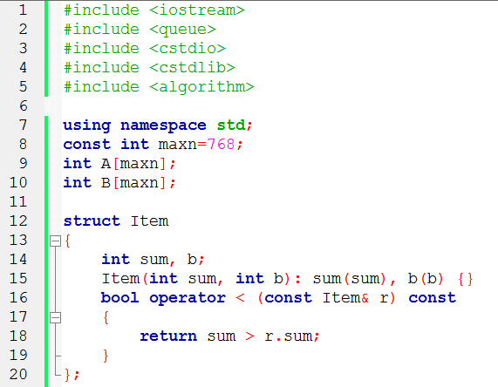

Slide 11
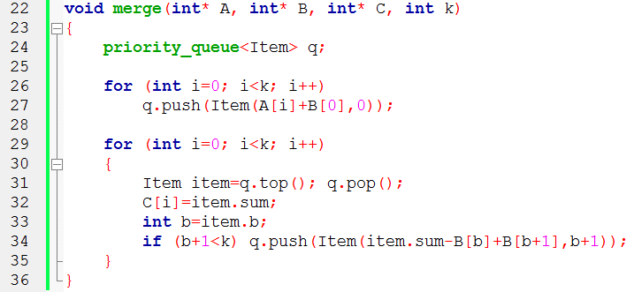
0 1 2
A
1 | 5 | 8
2 | 5 | 9
6 | 7 | 10
(3, 0) | (7, 0) | (10, 0)
A
3 | 6 | 7
B
(6, 1) | (7, 0) | (10, 0)

Slide 12
